Slide 1
Technical Support (420-1N6-AB) Disks: Additional Topics
Fall 2021

Slide 2
MBR-GPT

Slide 3
Windows Disk Settings
Windows installation automatically prepares the primary disk.
When new disks is added, you must:
Select a partitioning style.
Select a disk type.
Divide the disk into partitions or volumes.
Format the partitions or volumes with a file system.

Slide 4
Selecting a Partition Table Style
Partition table can describe the partitions on disk.
If the disk partition table is lost, users are unable to read disk data and write new data on it.
1- Master Boot Record (MBR)
Standard Partition table format since early 1980s.
Common partition style for x86- and x64-based computers.
2- GUID Partition Table (GPT)
GPT is the successor of MBR partition table format.
New since the late ’90s.
Most operating systems now support GPT.

Slide 5
GPT vs. MBR
MBR | GPT
- Supports up to 4 primary partitions or - 3 primary partitions and 1 extended partition, with unlimited logical drives on the extended partition. | Supports up to 128 primary partitions.
Supports volumes up to 2 TB | Supports volumes up to 18 Exabytes
Hidden (un-partitioned) sectors store data critical to platform operation. | Partitions store data critical to platform operation.

Slide 6
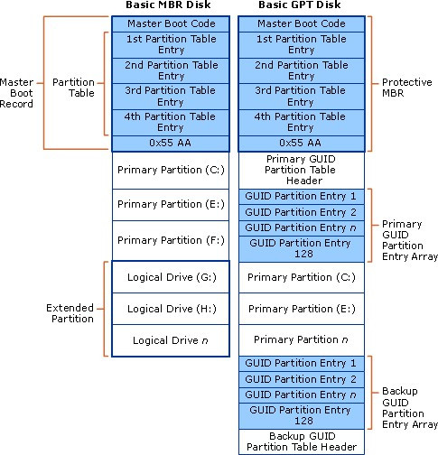
MBR vs GPT

Slide 7
Disk Types
Dynamic Disk
Basic Disk
Supported by Windows 2000 and later.
Does not use traditional partitioning.
Enables you to perform disk and volume management without the need to restart the computer. (Running Windows OSs).
Dynamic disks can combine two or more physical disks into one dynamic disk.
Dynamic disks divided into volumes. (not partitions).
Compatible with older OS.
Consists of primary and extended partitions.
Supports up to 4 partitions (per single hard drive)
Basic disks also can be configured for any of 3 RAID levels:
Disk striping (RAID 0)
Disk mirroring (RAID 1)
Disk striping with parity (RAID 5)

Slide 8


Partitions\ with MBR & GPT
Primary and extended partitions on a basic disk using MBR
Primary partitions on a basic disk using GPT

Slide 9
Primary vs. Extended Partitions
Extended | Primary
Extended partitions cannot host an operating system. | Primary partitions look like a physically separate disk. Can host an operating system.
Extended partitions cannot be marked as an active partition. | Can be marked as an active partition (bootable).
A basic disk using MBR can contain only 1 extended partition, but unlimited logical drives. | On a basic disk using MBR, you can create up to 4 primary partitions or 3 primary partitions and 1 extended partition.
You do not format the extended partition itself, but the logical drives it contains. You assign a unique drive letter to each logical drive. | You format each primary partition and assign a unique drive letter.

Slide 10
Volume Types
Simple volume
Spanned volume
Striped volume
Mirrored volume
RAID-5 volume

Slide 11
Simple Volume
A portion of a disk or an entire disk that is set up as a dynamic disk.
Can be extended onto multiple sections of the same disk.
Can be extended to multiple disks to be a part of a spanned or striped volume.

Slide 12
Spanned Volume
Combines space from multiple dynamic disks to a singe large volume.
As new disks are added, the spanned volume can be extended to include new disks.
One disk is filled before moving onto the space of another disk.
It does not increase performance.
It does not provide fault tolerance.

Slide 13
Striped Volume (RAID0)
Combines space from multiple dynamic disks to a single large volume.
You cannot extend it after creation.
Data is written equally across all disks.
Increases disk performance.
No fault tolerance.

Slide 14
Mirrored Volume (RAID1)
Consists of an identical amount of space on 2 physical disks, which must be dynamic.
The system performs read/write operations on both disks simultaneously.
One of the most guaranteed forms of disk fault tolerance.

Slide 15
RAID-5 Volume
Requires a minimum of 3 disk drives.
Parity information is distributed on each disk.
If one disk fails, the information on that disk can be reconstructed.
Improved read performance because of disk striping.
Slower write performance because of the parity calculations.

Slide 16
Disk Imaging & Cloning

Slide 17
Disk Image
A complete copy of the computer disk, includes:
System files.
Device Drivers.
Installed applications.
User profiles and data.
A disk image is one huge compressed file of the disk.

Slide 18
Disk Image
A created disk image can be deployed on a new disk drive if:
The old disk malfunctions.
Upgrade to a new disk (larger in size or faster).
Once an image is deployed on a disk, the new disk can be placed in a computer.
You should be able to carry on working with all your applications and data available on the new disk.
You will lose any data and modifications made to your system after the image was created.
Example:
You want to replace your disk with a larger size disk. You create a disk image and save it to an external drive. Afterward, you remembered you need to modify some photos. You install Photoshop application and download the photos to modify and save them to disk. While working on the photos, the system disk fails because of a HW issue. You install a new disk and deploy the image on it. You will see that the photoshop application and the downloaded photos will not be available there.

Slide 19
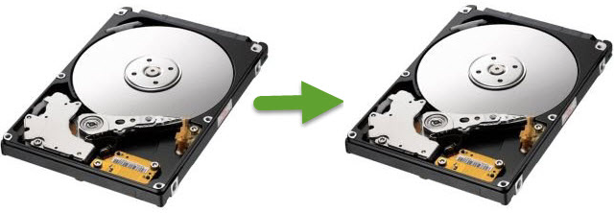
Disk Cloning
Copying the contents of a computer disk to another disk.
(or to an image file).
Includes:
Copying hidden files.
Files that are currently in use.
Deleted files. How?*
In cloning, hardware must be identical.
What happens if the disks do not have the same size?

Slide 20
Imaging VS Cloning
Both methods are used to create an exact replica of your hard drive.
Include files, master boot record, applications and OS.
Full system backup.
Cloning: exact copy of everything bit by bit on the disk
Imaging: creates one single compressed file (containing everything).
If your hard drive dies:
You can simply swap it with a clone (disk).
An image needs to be deployed on a new disk before you can go back to work.

Slide 21
Q & A
Notes:
In Slide Show mode, click the arrow to enter the PowerPoint Getting Started Center.

